Slide 1
PYTHON PROGRAMMING
LAUNCHCODE
September 6, 2025
Asfand Khan

Slide 2
Questions + Homework Review
https://github.com/Asfandyar-Khan/LaunchCode/
Contains lectures
Powerpoint files
Google Colab
Contains homeworks
To be completed prior to class
Any unfinished or challenging questions are taken up at the start of class
Project must be picked by today
Any questions about the project topics/ideas/code?

Slide 3
Review of Past Class
Week 8 Homework Review
Python Project Ideas – Finalization
Conditionals
Boolean expressions
If/Else statements
Chained conditionals
Dictionaries
What are they and why are they useful?
How do we use them in Python?

Slide 4
Today We Will Cover...
Python Project Ideas – Finalization – Those who missed class
If/Elif/Else statements – Review
If/Elif/Else statements - Knowledge Check
Boolean Expressions
What are they?
How are they used in Python?
Dictionaries
What are they and why are they useful?
How do we use them in Python?
Introduction to Classes and Functions

Slide 5
Conditionals
Conditionals let your program make decisions and choose different paths!
If: The starting point – “if this condition is true, then do this”
elif: Short for “else if”. Checks another condition only if the previous one was false
else: “If none of the above conditions is true, then do this instead”

Slide 6
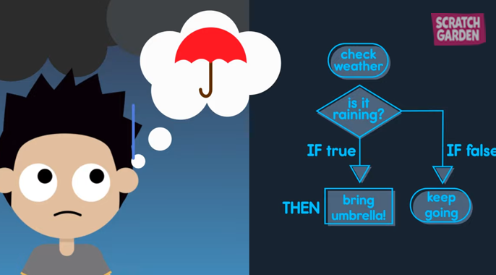
Conditionals – If/Else Statements

Slide 7
Conditionals – Comparison Operators
Conditions are built using comparison operators:
== (equal to)
!= (not equal to)
> (greater than)
< (less than)
>= (greater than or equal to)
<= (less than or equal to)

Slide 8
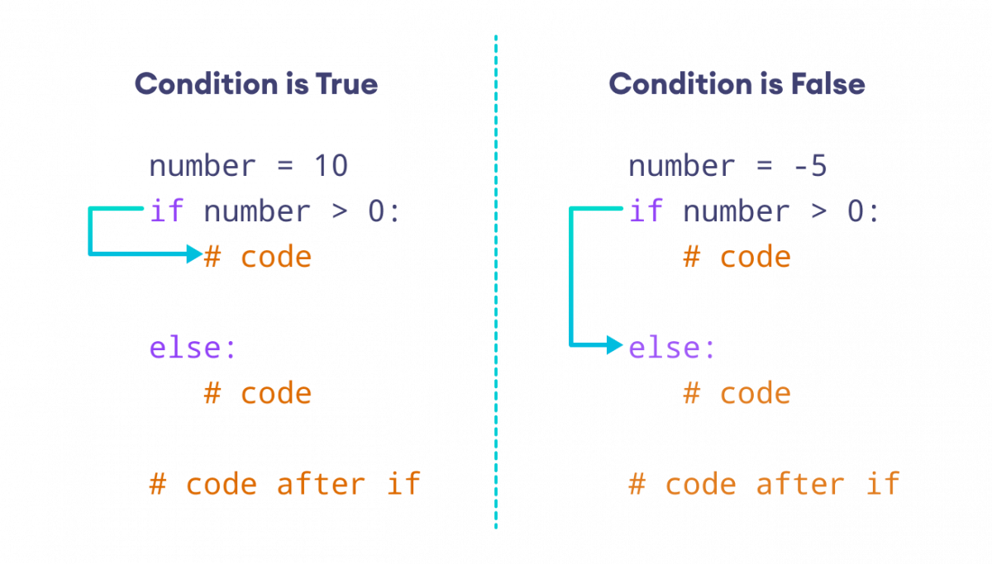
Conditionals – If/Else Syntax

Slide 9
Conditionals – If/Else Example
weather = "raining"
if weather == "sunny":
print("Wear sunglasses! 😎")
elif weather == "raining":
print("Don't forget your umbrella!☔")
else:
print("Have a great day! 🙂")
# This would print: "Don't forget your umbrella! ☔"

Slide 10
Knowledge Check – If Statement
Question: Number Checker
You have a variable that stores someone’s age:
Age = 16
Write an if/elif/else statement so the program prints:
"You are a child" if age is less than 13
"You are a teenager" if age is between 13 and 19 (inclusive)
"You are an adult" otherwise
Hint: Start with
if age < 13:

Slide 11
Boolean Expressions
What are Boolean Expressions?
A Boolean expression is a statement that can only be True or False
Think of it like a yes/no question in math or logic
Example questions:
Is 5 greater than 3? → True
Is 2 equal to 4? → False
Booleans are like a light switch: ON = True, OFF = False

Slide 12
Knowledge Check – Boolean
1. True or False
7 > 3 → ______
5 == 10 → ______
12 != 12 → ______
2. Multiple Choice
Which operator means “not equal to”?
A) ==
B) !=
C) >=
D) <

Slide 13
Dictionaries – New Data Type
What are Dictionaries in Python?
A dictionary is like a real dictionary: it matches a word (key) to its definition (value)
In Python, dictionaries store data in pairs:
Key → like a label (e.g., "name").
Value → the information connected to that label (e.g., "Alice").
Keys must be unique (you can’t have two keys with the exact same name).
Dictionaries are written with curly braces { }.
Example: student = {"name": "Alice", "age": 12, "grade": "7th"}
What is a key and value in the above example?

Slide 14
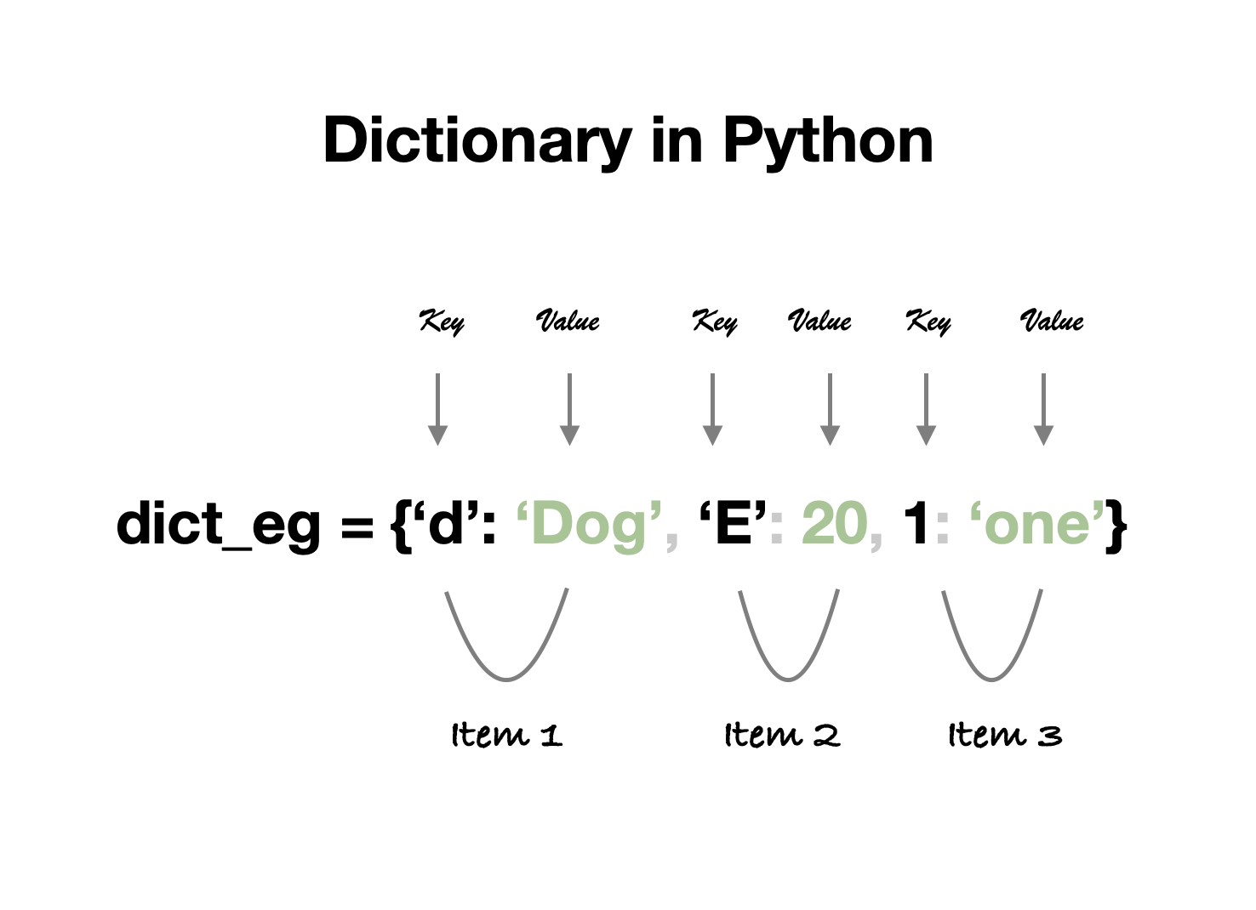

Slide 15
Dictionaries cont’d.
Why are Dictionaries Useful?
Organized storage → You can group related information together (like a profile).
Fast lookups → You can find data quickly using a key (instead of searching a whole list).
Flexible → Values can be numbers, strings, lists, or even other dictionaries!
Easy to update → You can change, add, or remove information easily.
Real-world use → Perfect for things like:
Storing a student’s info (name, age, grade).
Keeping track of game scores (player → points).
Making contact lists (name → phone number).

Slide 16
Knowledge Check – Dictionaries
Question 1: Accessing Values
If you have this dictionary:
student = {"name": "Alice", "age": 12, "grade": "7th"}
What does student["grade"] return?
A) "Alice"
B) "12"
C) "7th"
D) Error

Slide 17
Knowledge Check – Dictionaries
Question 2: Updating a dictionary
You start with:
scores = {"Alice": 10, "Bob": 8}
After running scores["Bob"] += 5, what is Bob’s new score?
A) 5
B) 8
C) 13
D) Error

Slide 18
Classes in Python
What are Classes in Python?
A class is like a blueprint for making new types of objects
Python already has built-in types (numbers, strings, lists, etc.), but we can create our own types
A class can hold:
Data → called attributes (like variables inside the object)
Actions → called methods (functions inside the object)
Creating an object from a class is called instantiation
Example idea:
class Time: → makes a new type for times of day
lunch = Time() → creates a new Time object

Slide 19
Attributes in Python
An attribute is a piece of information stored inside an object
We use the dot operator (.) to create or access attributes
Example idea (using a Time object):
lunch.hour = 11
lunch.minute = 59
lunch.second = 1
Attributes describe the object’s state (here: 11:59:01 → lunch time)
We can use attributes in calculations or display them in messages

Slide 20
Functions and Objects
We can write functions that use objects
Example idea: a function print_time(time) could show the time as 11:59:01
Functions can also return objects
Example: make_time(11, 59, 1) returns a new Time object
Objects can be changed (mutable) → their attributes can be updated
We can also make copies of objects to avoid changing the original

Slide 21
Review and Questions
Homework will be posted tomorrow!
Asfand Khan

